Slide 1
CUTe 7321c
Dharani Chinthalapuram Kumar
SULAIMAN SHAIK
PARAMITA CHAKRABORTY

Slide 2
Problem Statement
Given data contains details of various calls made to the Lifeline Services
It is a classification problem with 6 classes : - ASK_A_DOCTOR, MISCELLANEOUS, MISCELLANEOUS, LAB and JUNK
For each of the calls, the conversation has been given in text
Text has stop words, certain spelling typos and other medical terms
Accuracy is the metric that we would consider

Slide 3
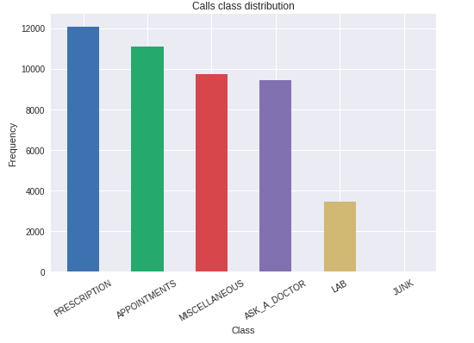
Check the distribution of classes

Slide 4
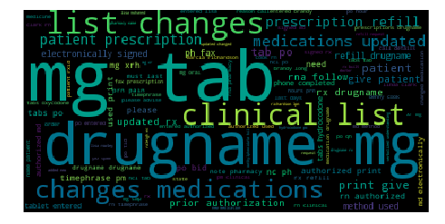
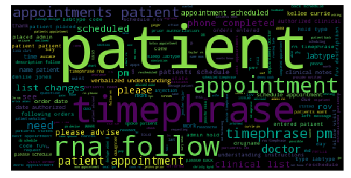
Word distribution across classes
PRESCRIPTION
APPOINTMENTS

Slide 5
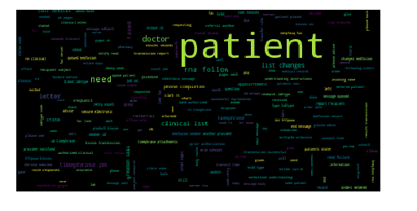
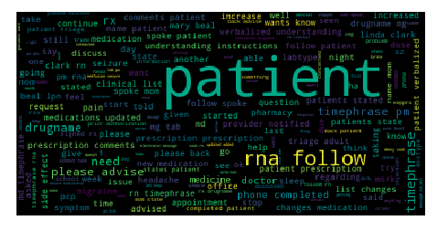
Continued…
MISCELLANEOUS
ASK_A_DOCTOR

Slide 6
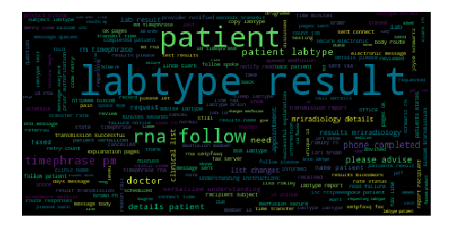
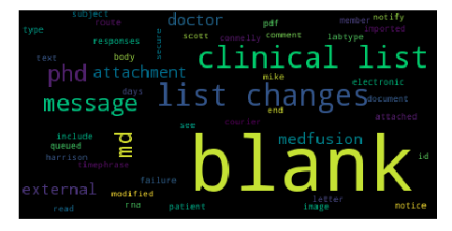
Continued…
LAB
JUNK

Slide 7
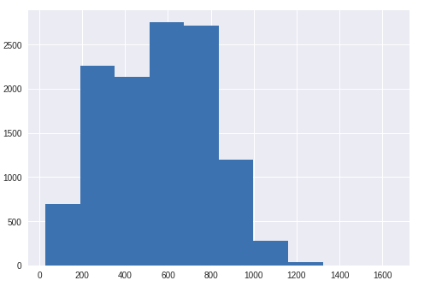
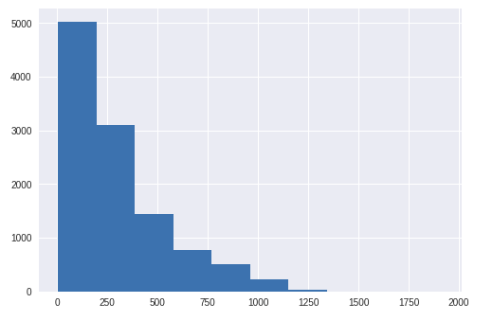
Text Length Across Classes
PRESCRIPTION
APPOINTMENTS

Slide 8
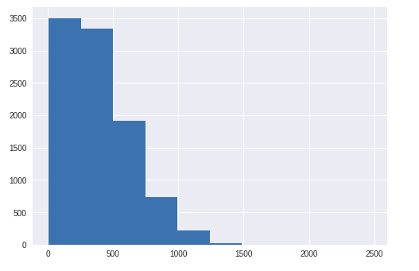
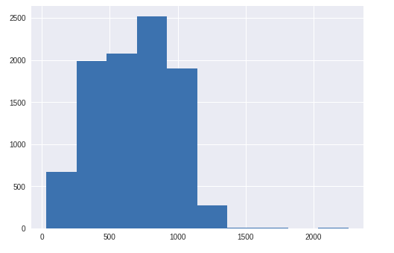
Continued…
MISCELLANEOUS
ASK_A_DOCTOR

Slide 9
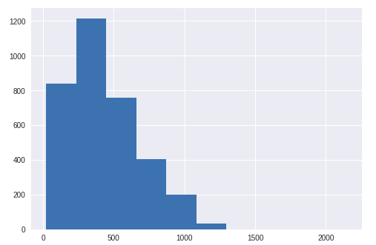
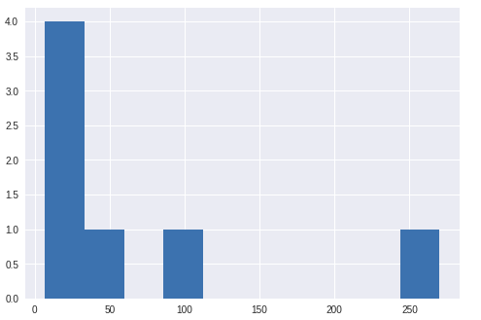
Continued…
LAB
JUNK

Slide 10
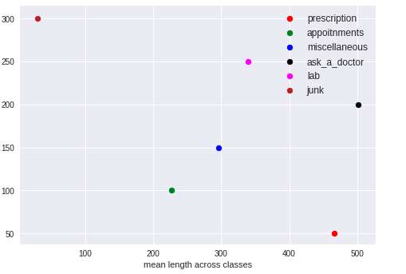
Average length of conversation across Classes

Slide 11
Data Preprocessing
Merge the train and test data
Removed the stop words, numbers etc.
Convert to lower case (required as we used GloVe)
Imputed the converse column with value as ‘BLANK’

Slide 12
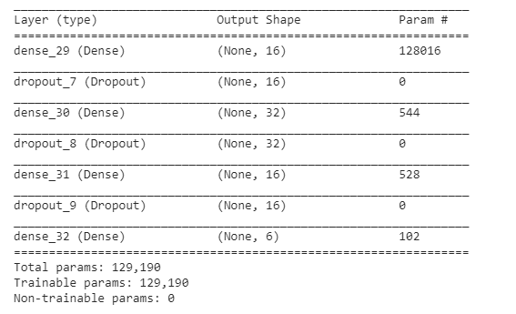
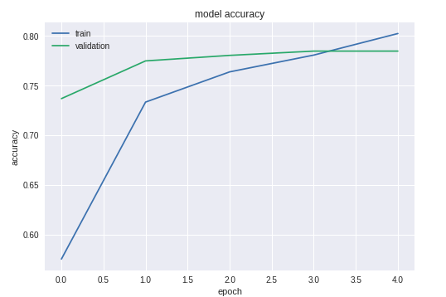
Model 1 – MLP with word frequency matrix
Accuracy: 39%

Slide 13
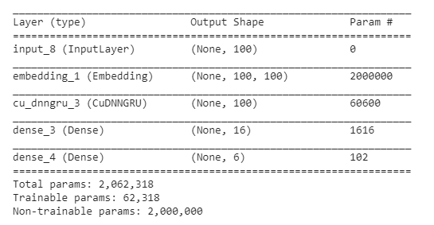
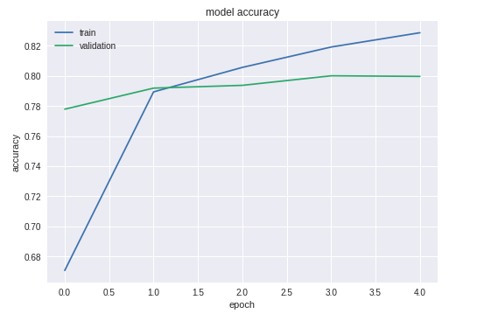
Model 2- GRU with GloVe Word Embedding
Accuracy: 79.3%

Slide 14
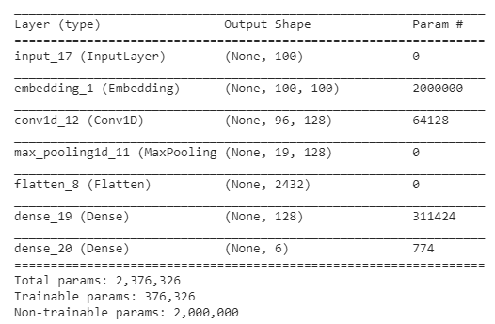
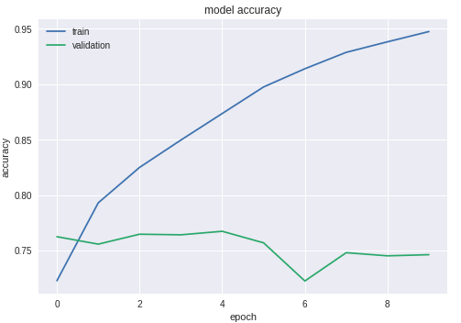
Model 3- CNN with GloVe Word Embedding
Accuracy: 72%

Slide 15
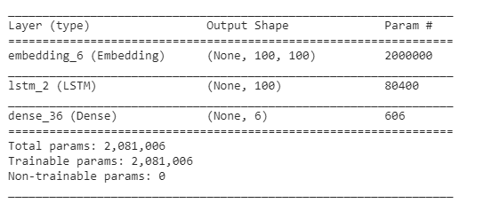
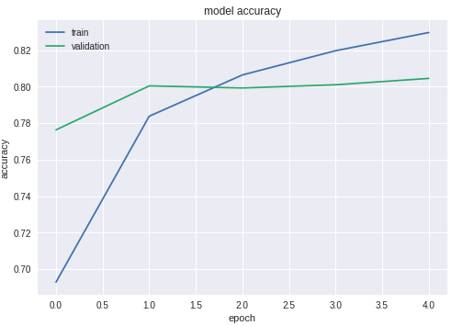
Model 4- LSTM with Word Embedding
Accuracy: 79.8%

Slide 16
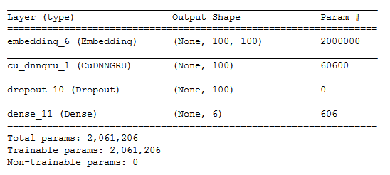
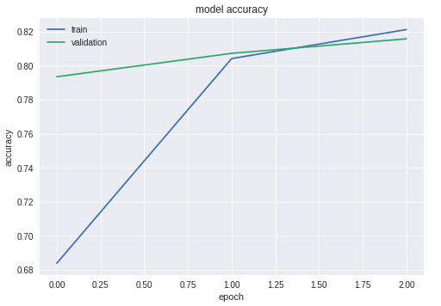
Model 5 – GRU with Word Embedding
Accuracy: 80.3%

Slide 17
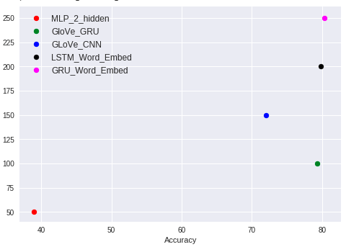
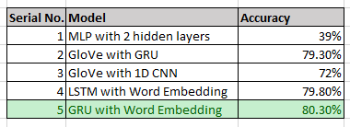
Model Summary

Slide 18
Learnings!!
The data set is quite simple, hence SVM and Naiive Bayes gives a test accuracy of 84%
Neural Networks clearly over-fit the data, making it very important to reduce the number of parameters to be trained, use regularization and keep a good amount of validation data while training
Usage of pre-trained word embedding models give a reasonable accuracy, as there are less number of parameters to be trained
There seems to be a pattern in the sequence of the words, hence LSTM/GRU with rmsprop Optimizer gives better accuracy than MLP/CNN
While training the Neural Network model, it sometimes gets stuck in local minima and hence gives a poor accuracy

Slide 19
Thank You

